Slide 1

Your Logo Here
(Not to exceed size of orange box)
ICU Program - Leadership Presentation
Improving Emotional Health
Notes:
Please refer to the ICU Program Implementation Guide for ideas on how to use this presentation.
Depending on the structure of your organization and level of understanding, you may not need to use all the slides.
You can tailor the slides to match your resources and might reorder the slides to best seek buy-in for the program and plan for your organization’s implementation.

Slide 2
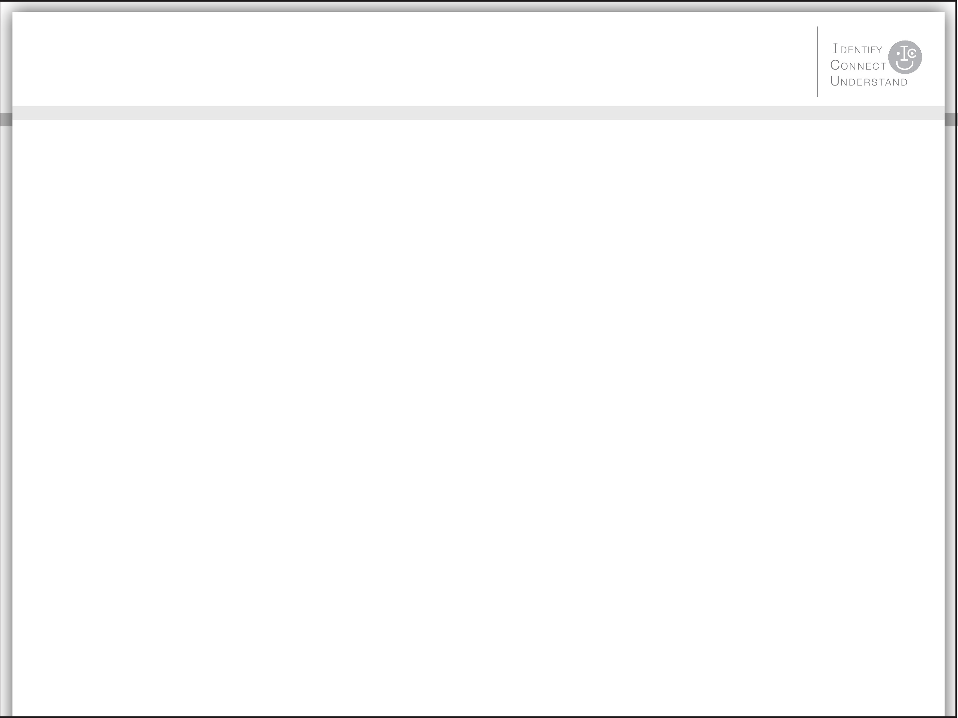
Your Logo Here
(Not to exceed size of orange box)
AGENDA
What Is the ICU Program?
Business Case for the ICU Program
Embrace the ICU Concept
Expected Outcomes
Take Action
Notes:
What we’ll be discussing today is a direct-to-employee campaign to improve emotional health.
ICU is a program to help colleagues recognize the signs of emotional distress in one another and refer people to appropriate help.
By creating a supportive environment, we take preventative measures that also help colleagues who may be experiencing more serious psychological ill health.

Slide 3
Your Logo Here
(Not to exceed size of orange box)
WHAT IS THE ICU PROGRAM?
The ICU Program is an awareness campaign to improve emotional health.
A five-minute ICU video is used to convey an analogy that just as people with a physical injury or illness may require help through an Intensive Care Unit, so people in distress or with a psychological/emotional injury or illness may require help from one another through the three steps of Identify, Connect, and Understand.
ICU thus becomes “I See You.”
Physical Health | “I See You” | ICU Steps to Improve Emotional Health
Intensive | I | Identify the signs
Care | C | Connect with the person
Unit | U | Understand the way forward together
Notes:
ICU thus becomes “I See You” through three steps:
Identify the signs of distress.
Connect with the person.
Understand the way forward together.

Slide 4
Your Logo Here
(Not to exceed size of orange box)
WHAT IS THE ICU PROGRAM?
The ICU concept was developed in 2011 at DuPont by European and U.S. members of their Integrated Health Services (Employee Assistance Program and Occupational Medicine) team in support of two of their core values: Respect for People and Safety and Health.
The ICU video has been delivered to DuPont’s 70,000 employees worldwide to support an emotionally safe workplace.
DuPont generously donated the ICU concept to the Partnership for Workplace Mental Health to create a universal version that we can adopt.

Slide 5
Your Logo Here
(Not to exceed size of orange box)
BUSINESS CASE FOR THE ICU PROGRAM
Emotional distress affects business through the connection between mental and emotional health and productivity.
Emotional distress does not mean a mental illness exists, but distress can still negatively affect performance; left unaddressed, performance can worsen.
Excessive demands resulting in stress may contribute to difficulty managing emotions, focusing attention, making decisions, and thinking clearly or objectively.¹
Reduced distress can lead to enhanced resilience, strengths in employee satisfaction, recruitment and retention, absence reduction, work engagement, productivity, and financial performance.²

Slide 6
Your Logo Here
(Not to exceed size of orange box)
BUSINESS CASE FOR THE ICU PROGRAM
A total of 25% of the adults in the United States experience mental illness in a given year.³
Mental illnesses cause more days of work loss and impairment than physical ailments such as arthritis, asthma, back pain, diabetes, hypertension, and heart disease.⁴
Mental illness short-term disability claims are growing by 10% annually.⁵
Discrimination charges against employers show the greatest increase in nonvisible disabilities such as anxiety, bipolar disorder, manic depression, PTSD, and depression.⁶

Slide 7
Your Logo Here
(Not to exceed size of orange box)
BUSINESS CASE FOR THE ICU PROGRAM
What untreated—or poorly treated—emotional distress or mental illness can look like in work performance and productivity.
Symptoms of distress | = | Signs that affect work productivity
Sleep problems | = | Lower quality work, lateness to work
Lack of concentration | = | Procrastination, more accidents on the job
Slowed thoughts | = | Indecision or trouble making decisions
Aches and pains | = | Trips to the doctor, increased healthcare costs
Forgetfulness | = | Poor quality work
Self-medication | = | Missed deadlines, absenteeism
Irritability or tearfulness | = | Poor relationships with coworkers, boss, or clients
Low motivation or morale | = | Presenteeism
Notes:
While the ICU video gives general information on what distress may look like in colleagues, here are a few other descriptions of what distress or mental illness may look like in the workplace.

Slide 8
Your Logo Here
(Not to exceed size of orange box)
BUSINESS CASE FOR THE ICU PROGRAM
Why don’t people speak up when they see others in distress?
Fear of invading privacy
A perception that it is not allowed or not businesslike to reach out
A lack of comfort and not knowing how
Why don’t people seek help on their own?
They don’t want to admit that they are unwell.
They are afraid that it will adversely affect their work status.
They are embarrassed due to stigma about emotional distress and mental illness.
They feel alone.
Notes:
ICU encourages employees to create an environment where it is safe to connect and offer support.

Slide 9
Your Logo Here
(Not to exceed size of orange box)
EMBRACE THE ICU CONCEPT
We have programs and resources that can help employees; the challenge is getting people to access them.
The ICU Program will help us promote our resources and encourage people to use them.
We can make our workplace a supportive community by allowing employees to reduce distress by simply talking with someone.⁷
We can implement an internal awareness program quickly with resources we already provide.

Slide 10
Your Logo Here
(Not to exceed size of orange box)
EMBRACE THE ICU CONCEPT
Through the ICU Program, we can create an environment where we equip our employees to recognize the signs of distress and refer each other to the resources already available.
Our employee assistance program
Our mental health and substance use disorder benefits
Interventions can help. The majority (65–80%) of those suffering from emotional distress or mental illnesses will get better with proper treatment—a success rate that exceeds many nonpsychiatric illnesses.⁸
Notes:
This slide is intended to be adapted to your specific needs and plans.
Reference the Implementation Guide when planning and presenting.
Pay close attention to these sections:
Tailor the implementation guide
Use of the ICU peripheral materials
Reinforce the message
Track your success

Slide 11
Your Logo Here
(Not to exceed size of orange box)
EXPECTED OUTCOMES
Through the ICU Program and improving emotional health, we will:
Foster an emotionally safe environment
Create awareness of the programs we provide for employees
Encourage people to reach out for help—early
Encourage colleagues to connect and support one another

Slide 12
Your Logo Here
(Not to exceed size of orange box)
TAKE ACTION
Let’s launch the ICU Program!
What it will take?
Tailor the implementation guide to our needs.
Prepare referral resource information.
Share the ICU video.
Share the resource flyer, e-mail message, or link to our intranet site.
Reinforce the message.
Measure the effect—utilizing metrics we already have.
Notes:
This slide is intended to be adapted to your specific needs and plans.
Reference the Implementation Guide when planning and presenting.
Pay close attention to these sections:
Tailor the implementation guide
Use of the ICU peripheral materials
Reinforce the message
Track your success

Slide 13
Your Logo Here
(Not to exceed size of orange box)
TAKE ACTION : IMPLEMENTATION PART 1
Our launch of the ICU Program:
To create the buzz, small posters with the ICU Program logo will be in our break rooms a week before our all-hands meeting.
A four-question survey will be sent via push technology to all computer work stations the day before our all-hands meeting.
Viewing of the ICU video at our all-hands meeting on [DATE] after a short introduction by the CEO.
Flyers with our resources will be delivered to the desks and/or homes of all employees.
Notes:
This slide is intended to be adapted to your specific needs and plans.
Reference the Implementation Guide when planning and presenting.
Pay close attention to these sections:
Tailor the implementation guide
Use of the ICU peripheral materials
Reinforce the message
Track your success

Slide 14
Your Logo Here
(Not to exceed size of orange box)
TAKE ACTION : IMPLEMENTATION PART 2
Ongoing support of the ICU Program:
Conduct focus group with managers/supervisors on the impact of the ICU video and messaging.
Include the ICU video as a reminder in smaller team meetings semiannually.
Six months after the initial ICU video viewing, a follow-up four-question survey will be sent. These questions will then be included in our annual pulse/corporate climate survey.
The resource flyer is to be made available during health fairs and open enrollment.
The ICU video will be added to our new-hire onboarding meetings, and the resource flyer will be provided to new employees.
Notes:
This slide is intended to be adapted to your specific needs and plans.
Reference the Implementation Guide when planning and presenting.
Pay close attention to these sections:
Tailor the implementation guide
Use of the ICU peripheral materials
Reinforce the message
Track your success

Slide 15
Your Logo Here
(Not to exceed size of orange box)
TAKE ACTION : IMPLEMENTATION PART 3
Review of the ICU Program and our resources:
Analyze the results of the surveys and review other metrics semiannually.
Determine whether updates in our resources are necessary.
Notes:
This slide is intended to be adapted to your specific needs and plans.
Reference the Implementation Guide when planning and presenting.
Pay close attention to these sections:
Tailor the implementation guide
Use of the ICU peripheral materials
Reinforce the message
Track your success

Slide 16
Your Logo Here
(Not to exceed size of orange box)
TAKE ACTION : MANAGERS/SUPERVISORS
As managers/supervisors, you are in a unique position to notice the signs and symptoms of distress and to create an environment where it is safe for employees to seek the help they may need.
We ask that you:
Mention the ICU Program at team meetings.
Encourage participation.
Share the available resources.
Note: Recognize that neither managers/supervisors nor team members are to diagnose colleagues. Rather, refer those in visible distress to the resources that are available.

Slide 17
Your Logo Here
(Not to exceed size of orange box)
ENDNOTES
Rollin McCraty and Dana Tomasino, “Emotional Stress, Positive Emotions, and Psychophysiological Coherence,” in Stress in health and disease, B. B. Arnetz & R. Ekman (eds.), (Weinheim, Germany: Wiley-VCH, 2009), 342–364.
Partnership for Workplace Mental Health, Employer practices for addressing stress and building resilience (Arlington, VA: Partnership for Workplace Mental Health, August 2013). Available at www.workplacementalhealth.org/stress_whitepaper
National Institute of Mental Health, Statistics: Any Disorder Among Adults. (n.d.). Retrieved March 5, 2013, from http://www.nimh.nih.gov/statistics/1ANYDIS_ADULT.shtml
W. F. Stewart, Ricci, J. A., Chee, E., Hahn, S. R., and Morganstein, D. (June 18, 2003). Cost of lost productive work time among US workers with depression. JAMA: Journal of the American Medical Association 289(23): 3135–3144.
J. F. Marlowe. (March 2002). Depression’s Surprising Toll on Worker Productivity. Employee Benefits Journal 27: 16–20.
Sarah von Schrader and Zafar E. Nazarov, Discrimination Charges: Identifying Patterns and Employer Factors (2013, October). Panel conducted at the Employer Practices: State of the Science Conference in Arlington, VA. http://www.employerpracticesrrtc.org/projects/eeoc/
Mayo Clinic, Need stress relief? Try the 4 A's. (July 23, 2013). Retrieved from http://www.mayoclinic.org/healthy-living/stress-management/in-depth/stress-relief/art-20044476?pg=2
Health Care Reform for Americans with Severe Mental Illnesses: Report of the National Advisory Mental Health Council. (October 1993). Produced in response to a request by the Senate Committee on Appropriations, American Journal of Psychiatry 150: 10.

Slide 18
Your Logo Here
(Not to exceed size of orange box)
This ICU Program message is brought to you by the Partnership for Workplace Mental Health, a program of the American Psychiatric Foundation. The ICU concept was donated by DuPont.
Copyright © 2014 by the American Psychiatric Foundation. All rights reserved.
Not for commercial use.

Slide 19
Your Logo Here
(Not to exceed size of orange box)
TITLE GOES HERE
Notes:
This slide is included as a template for you to follow should you need additional Title slides in your presentation.

Slide 20
Your Logo Here
(Not to exceed size of orange box)
TITLE GOES HERE
Body Copy goes here
Notes:
This slide is included as a template for you to follow should you need additional content slides in your presentation.

